Slide 1
Detecting and overcoming GPU failures in ML training

Slide 2
Who we are

Slide 3



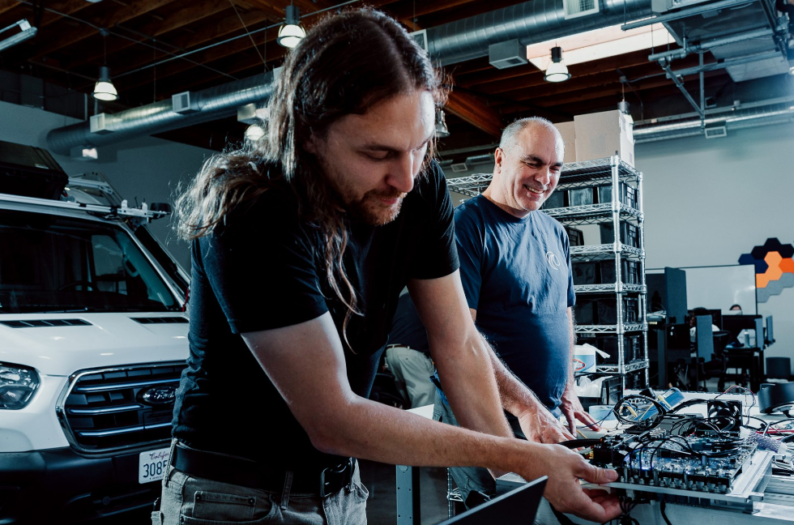

Pioneering a new way to solve self-driving with Embodied AI
Sarah Belghiti
ML PLatform Engineer
Wayve’s AI technology empowers vehicles to perceive, predict and progress through dynamic environments.
Notes:
I’m Sarah, ML Platform Engineer at Wayve.
At Wayve, we’re developing solutions to solve self-driving using AI, including in complex environments like urban areas.

Slide 4
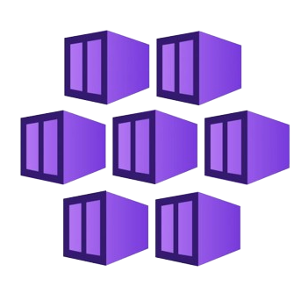


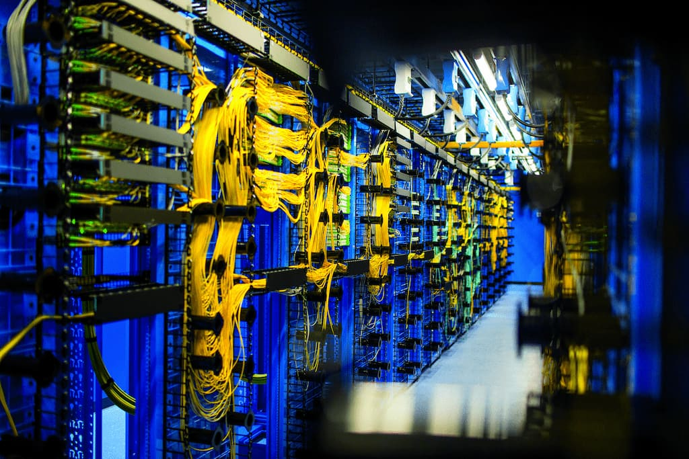
Deploy and scale containers on managed Kubernetes
Ganeshkumar Ashokavardhanan
Software Engineer
Azure Kubernetes Service
Simplify Kubernetes operations, build cloud-native apps, and innovate with AI and open-source technology.
Notes:
Wayve and Microsoft have been strategic partners since 2018, in 2020 Wayve chose Microsoft Azure to help accelerate the development of its AI (link), in 2022 Microsoft and Wayve extended their collaboration to develop supercomputing technologies with Azure for training Embodied Intelligence, this supercomputing infrastructure is powered by NVIDIA GPUs.
Microsoft first invested in Wayve in their Series B (2022) and reinvested in the company in their Series C fundraise (2024).

Slide 5
Agenda
Introduction
GPU failures
Impact on ML workloads
Detection
Resolution
Demo

Slide 6
Introduction
Why K8s for ML training?
Distributed systems
Enables multi-node training
Job scheduling tools (Volcano, Kubeflow, Kueue)
Gang scheduling
Plugin for AI frameworks
GPU device plugin / operator
Easy to manage access to relevant hardware components

Slide 7
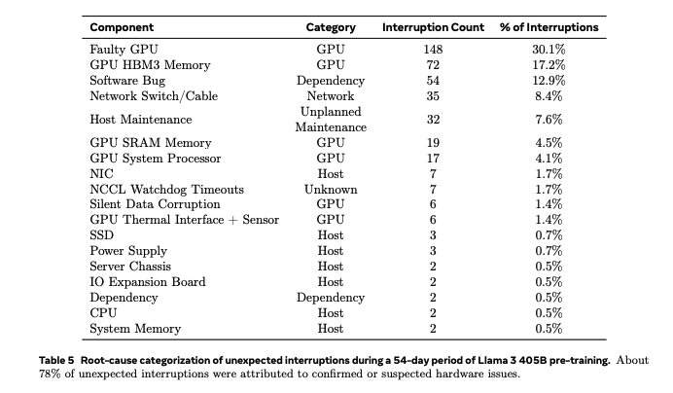
What are GPU failures?
GPU failures
GPU issues: 58.7% unexpected interruptions
GPUs are complex pieces of hardware, with a much higher likelihood of failure than CPUs.
The Llama 3 Herd of Models (Meta, July 2024):

Slide 8
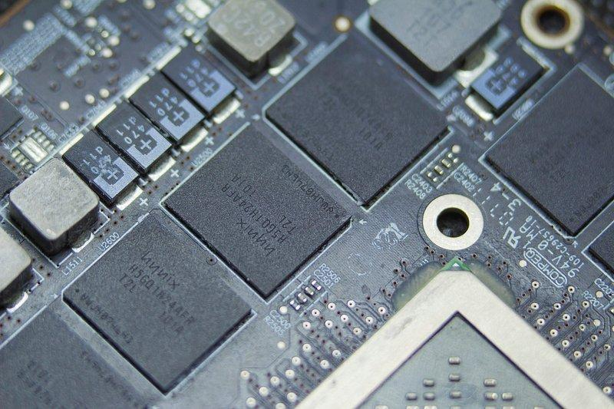
What are GPU failures?
GPU failures
Commonly affected components
GPU
GPU memory
Networking
GPU driver

Slide 9
Impact on ML workloads
Impact on ML workloads
Example of a H100 node (8 GPUs):
Public price: ~2000$/day
For a job that normally runs for 3 days, 6X slower: +$30,000
Failures
Hangs
Slow downs
EXPENSIVE $$$
Gradient synchronisation

Slide 10
Detection
Goals
Avoid workloads from being scheduled on faulty nodes
Remove jobs from faulty nodes during training
“Repair” or replace faulty nodes
✅

Slide 11
Detection
Solution 1: node readiness - detecting failure before the job starts
Runs as init container in the training job pods
Example: GPU bandwidth, NCCL tests, GPU errors
Training container can start.
Health checks succeed
The node is tainted and the pod terminates.
Health checks fail
🚫
Benefit: workloads don’t get scheduled on faulty nodes.

Slide 12
Detection
Solution 2: monitoring while jobs are running
Node
Workload
Background GPU health checks, metrics
Pros:
Easy to install with GPU operator
Can detect issues at the GPU level
Cons:
Doesn’t detect hangs
Examples: combined metrics (GPU utilisation vs Memory access), collective operation monitoring
Pros:
Can detect hangs
Cons:
More complex to implement
More difficult to identify the faulty GPU

Slide 13
Resolution - Job level
Job pre-emption & rescheduling
Save checkpoint
Terminate job
Schedule new job on new node
Restore from saved checkpoint

Slide 14
Resolution - Node level
“Repair” or replace the node
Reset /
Restart /
Reboot
Health checks
Untaint
Metrics
Taint
Logs
Error
Health checks
Drain & remove

Slide 15
Infra provider
perspective

Slide 16
Layers of failure detection
Workload
Health check before Running
1
Orchestrator
Node health checks for node and GPU readiness.
2
Virtual Machine Deployment
Prevent nodes from being available to the orchestrator
3
Physical Clusters
Perf tests during onboarding
4
Notes:
Focus on orchestrator layer: - GPU cluster tests initially -> Azure
VM level before deploying
k8s level/orchestrator (SLURM/TORQUE) after deploying -> Node init check or Node Problem detector
-> Before application runs
Note: create a flow chart
Q. Discuss about preventing GPU failures

Slide 17
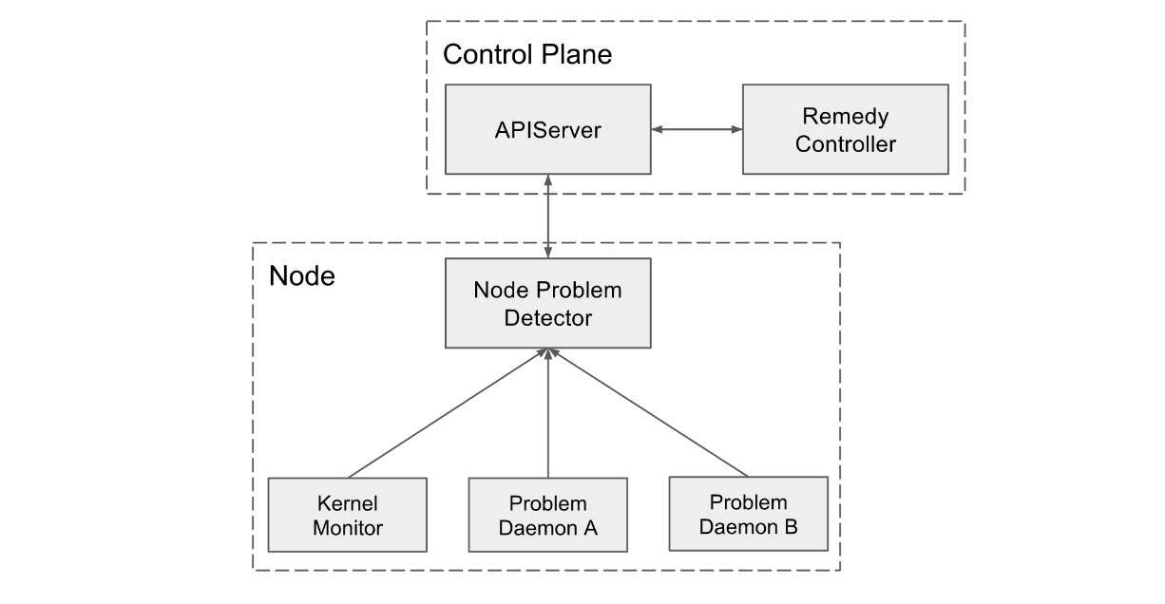
Node Problem Detector
Code: https://github.com/kubernetes/node-problem-detector
Notes:
Step back: how are node problems currently handled? Related to CPU, network, or runtime configuration
Similar Need upstream - like
Why GPUs special? Error propagation mechanisms non standard and GPU vendor dependent now. Should become better with DRA
During runtime/periodically
Currently, these problems are invisible to the upstream layers in the cluster management stack, so Kubernetes will continue scheduling pods to the bad nodes.
Infrastructure daemon issues: ntp service down
Hardware issues: Bad CPU, memory or disk
Kernel issues: Kernel deadlock, corrupted file system
Container runtime issues: Unresponsive runtime daemon
Can run at as a daemonset or standalone
Cloud providers often deploy it with their managed services

Slide 18
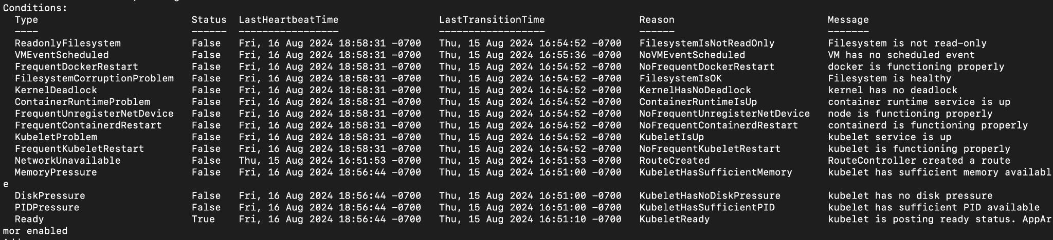
Node Problem Detector
Conditions
Default checks are not GPU specific

Slide 19
GPU Health Checks
Node-level health checks that can be run across the fleet
Custom health checks:
Cron jobs with health checks for specific GPU and network config
LBNL Node Health Checks (open-source)
Reliable (with timers to prevent hangs), extensible and reusable
Integrations with common HPC workload managers like SLURM and TORQUE
Azure HPC health checks (open-source and experimental)
Extension of LBNL’s node health check
Tested with multiple Nvidia A100 and H100 GPUs, and AMD MI300X
Notes:
Q. what are the differences between HPC-AI health checks and LBNL NHC ones?
LBNL Node Health Checks:
Reliable (with timers to prevent hangs), extensible and reusable
Integrations with HPC workload manager/schedulers like SLURM and TORQUE
- Custom health checks
- Azure HPC-AI health checks (open-source)
Extension of LBNL NH

Slide 20
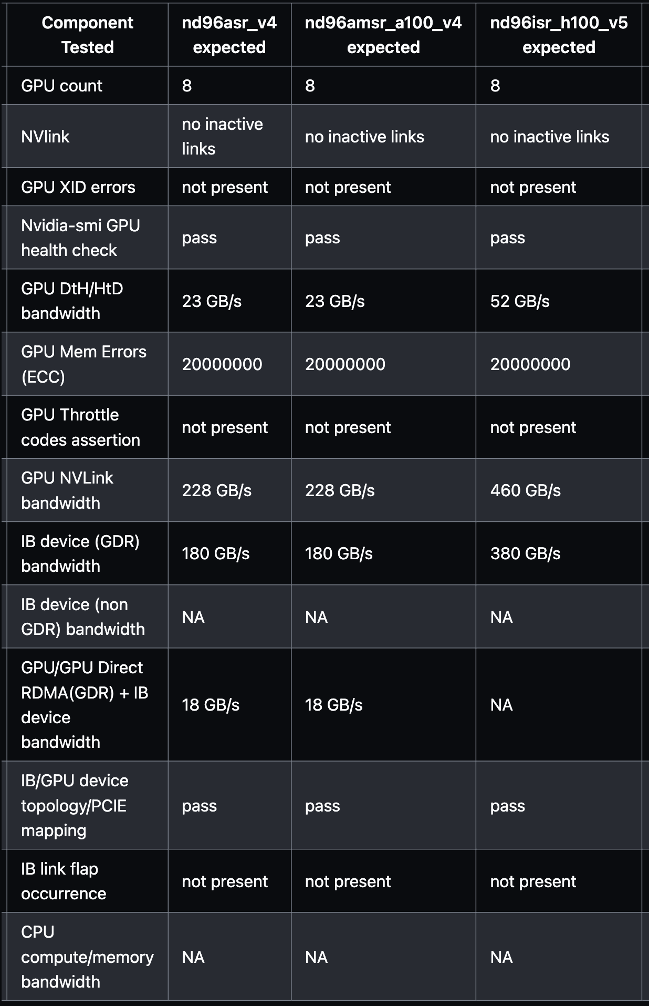
Example
health checks
Going beyond the k8s device plugin
Source:
https://github.com/Azure/azurehpc-health-checks/
Notes:
Q. what are the differences between HPC-AI health checks and LBNL NHC ones?
LBNL Node Health Checks:
Reliable (with timers to prevent hangs), extensible and reusable
Integrations with HPC workload manager/schedulers like SLURM and TORQUE
- Custom health checks
- Azure HPC-AI health checks (open-source)
Extension of LBNL NH

Slide 21
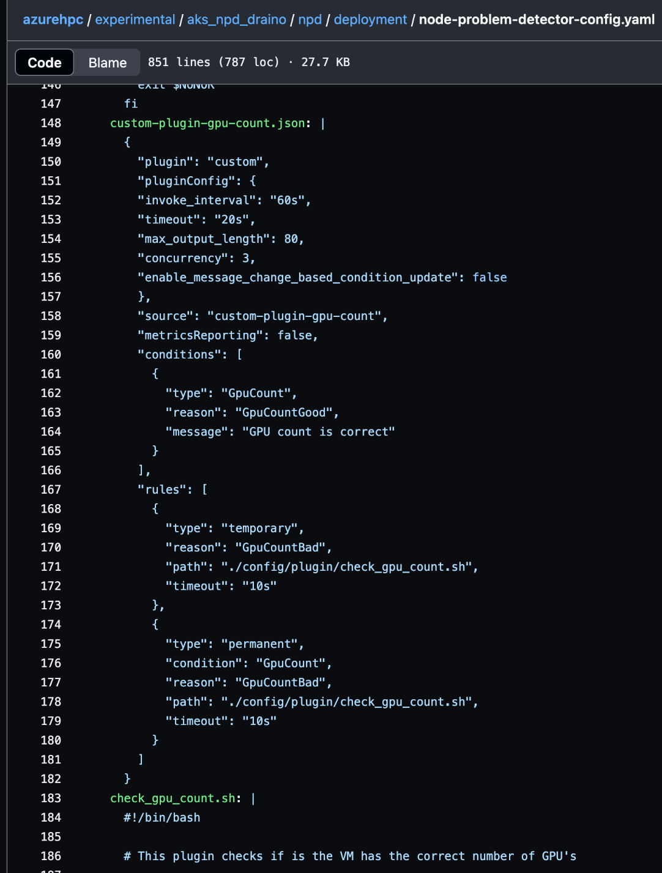
Custom plugin for NPD
Experimental phase
Notes:
Custom plugins for node problem detector
Need to re-build the NPD image
GPU specific health check
Add as a configmap to NPD daemonset
Or if cloud provider has one that can’t directly be modified, have a custom build for it

Slide 22
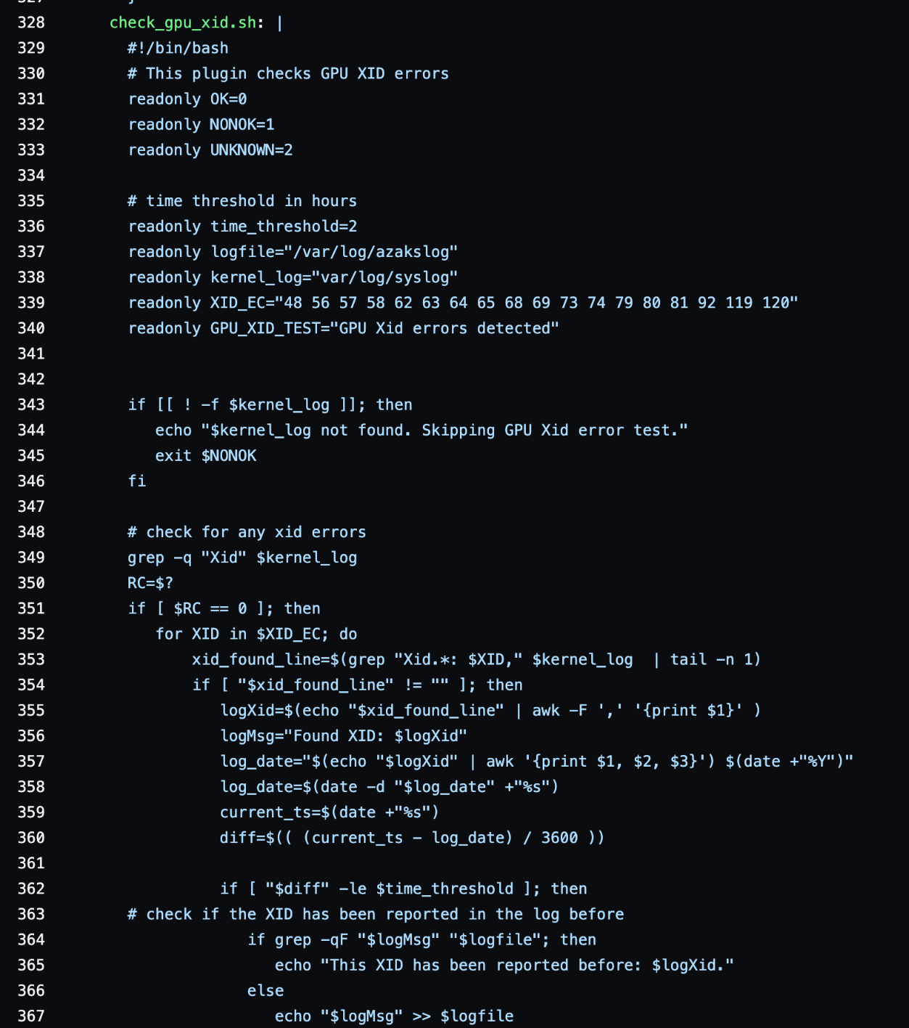
Custom plugin for NPD
Notes:
Custom plugins for node problem detector
Need to re-build the NPD image
GPU specific health check
Add as a configmap to NPD daemonset
Or if cloud provider has one that can’t directly be modified, have a custom build for it

Slide 23
Remedy Controller
Node “repair” or replace
Remedy Controller
Custom actions
Health checks
Remove node condition
Node Problem Detector
Error Node Condition
Node health checks
Error
Drain & remove
Notes:
Replace with a new node
Open-source solutions:
Draino:
Easy to use
Challenge: CVEs, unmaintained project
Cloud providers usually have similar components
Preventing nodes from being scheduled on again

Slide 24
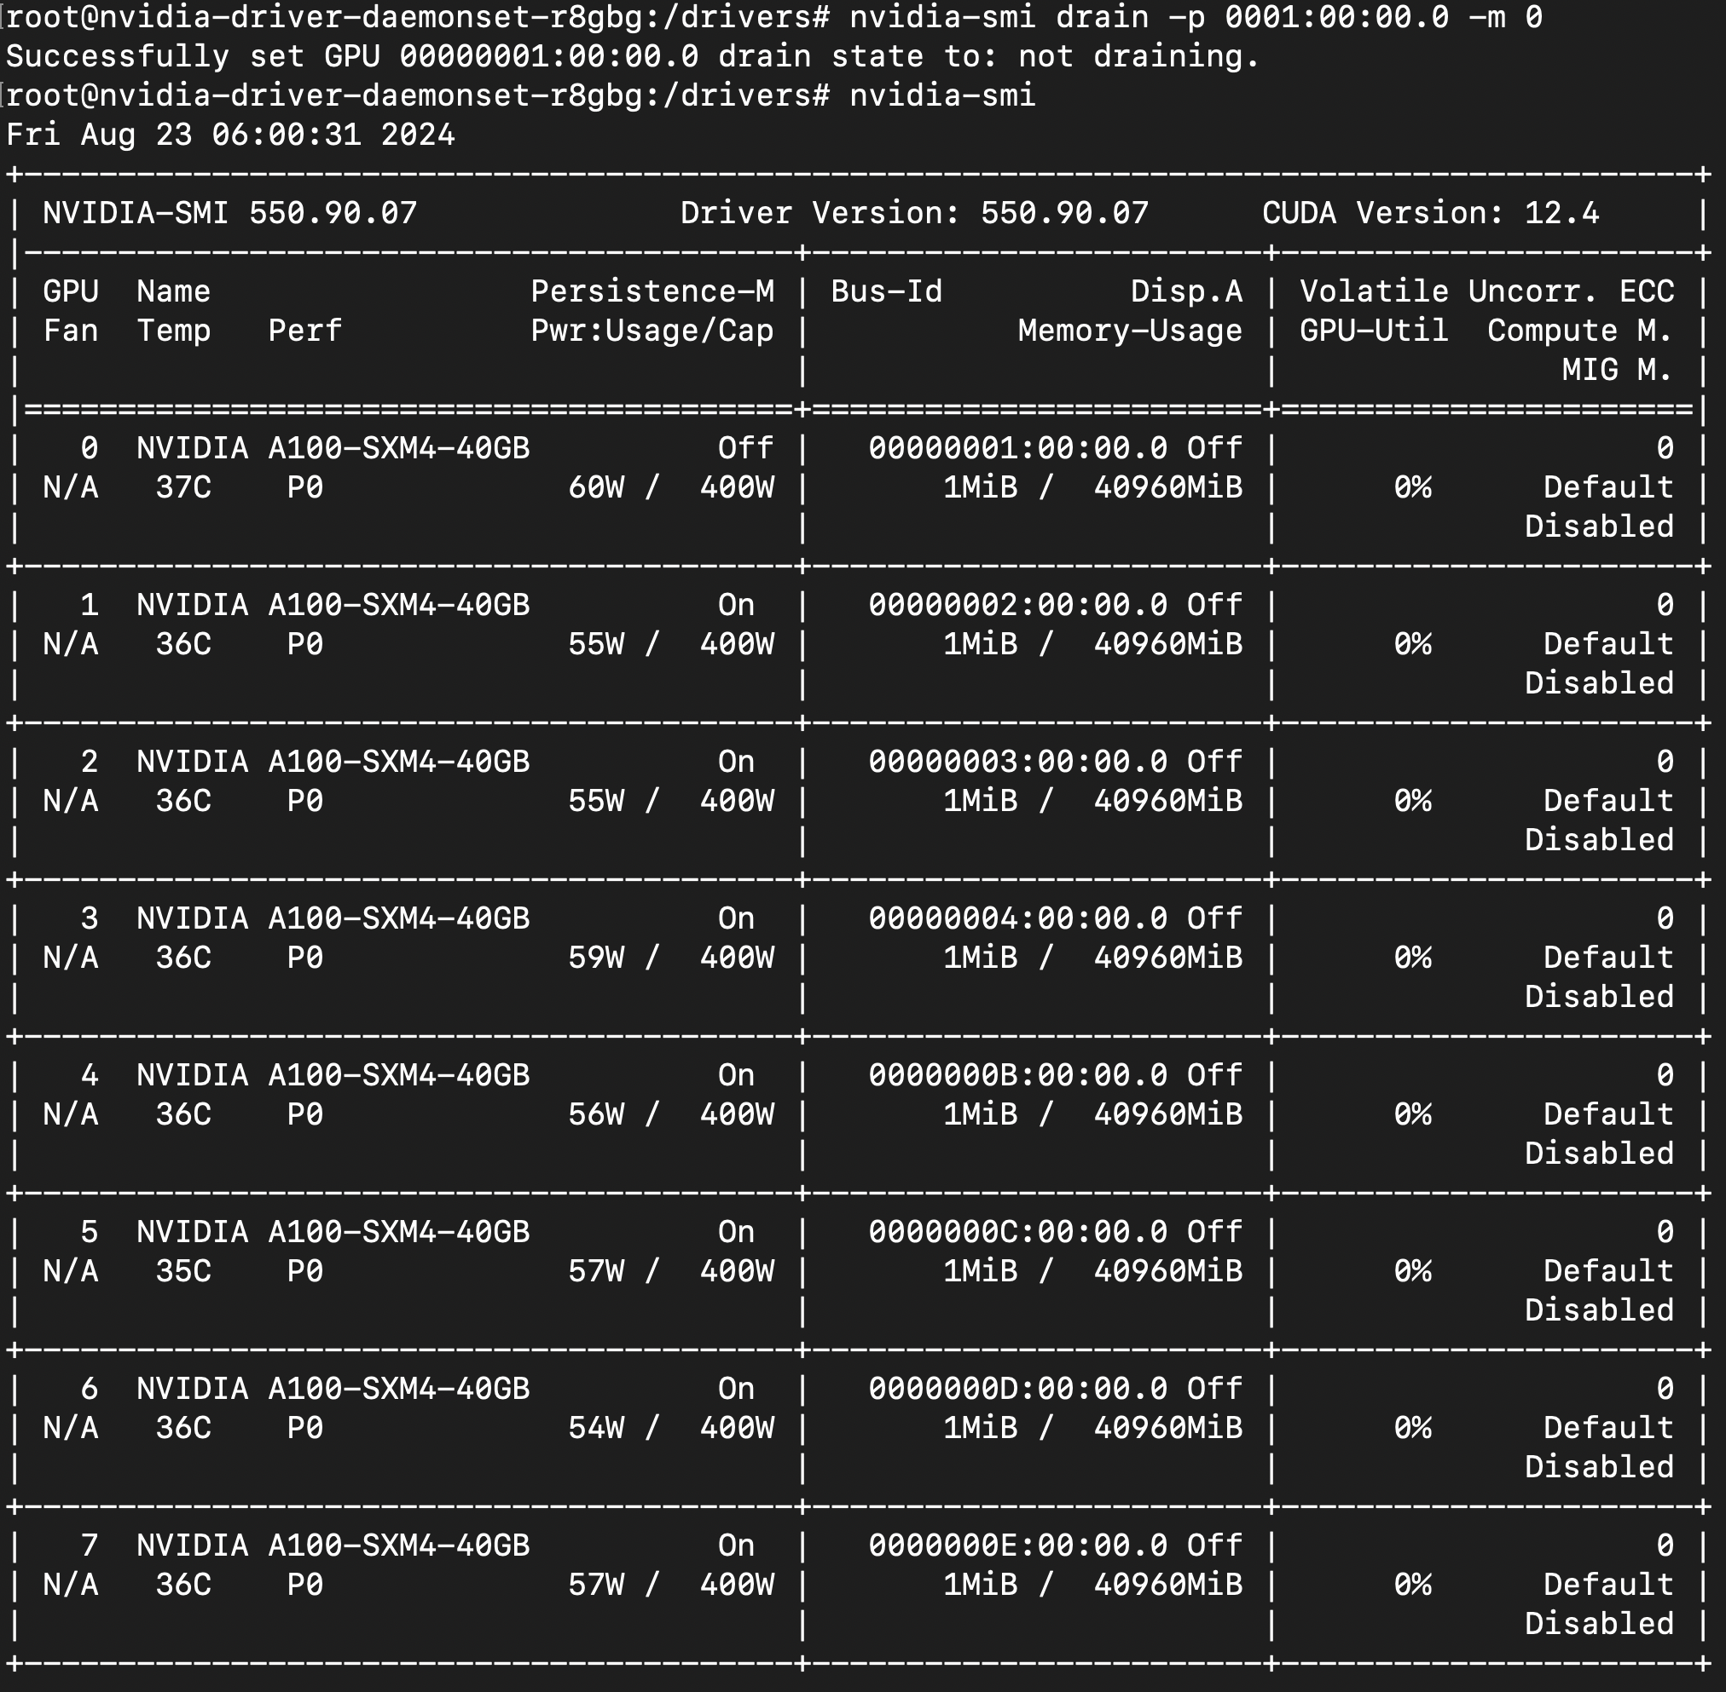


Testing by simulating failures
Virtual nodes: Kubernetes without kubelet
Network load testing
Network load testing
Notes:
Verbally Nvidia-smi drop:
IB failures
Tests based on custom health checks
KWOK

Slide 25
Demo: GPU Node Problem detector + Draino + Drop GPU

Slide 26
Notes:
Custom plugins for node problem detector
Need to re-build the NPD image
GPU specific health check
Add as a configmap to NPD daemonset
Or if cloud provider has one that can’t directly be modified, have a custom build for it

Slide 27
Challenges
Tests vary based on GPU and network setup
Resource consumption for health checks
Distinguishing between actionable and hardware issues + taking that node out of circulation

Slide 28



Advanced developments and Gaps
Checkpoint/Restore in Userspace for GPUs
GPU + k8s: more native integrations
Notes:
Checkpoint/Restore In Userspace for GPUs
Forensic checkpoint in kubernetes
Project Forge
GPU checks integrated with NPD - vendor neutral
Gaps:
Official mapping by GPU vendors with mapping between error codes and remedy actions, along with reasons
Predicting GPU failures

Slide 29
Key Takeaways
GPU failures are disruptive, and compound for ML Training
Multiple layers of health checks:
Applications - before running: Init containers
Orchestrator - while running: GPU node health checks
Resolution:
Checkpointing model weights
Remedy control systems - move workload
Prevent node reuse
Ongoing work: CRIU w/ GPU, making GPU health more k8s-native

Slide 30
Thank you

Slide 31
Useful links
https://naizhengtan.github.io/doc/papers/liu23predicting.pdf
https://ai.meta.com/research/publications/the-llama-3-herd-of-models/
https://github.com/mej/nhc/
https://adaptivecomputing.com/cherry-services/torque-resource-manager/
Checkpoint and restore for GPUs: https://github.com/checkpoint-restore/criu/issues/2326

Slide 32
References
Steps to customize NPD for GPU support: https://techcommunity.microsoft.com/t5/azure-high-performance-computing/gpu-node-health-checks-integrated-into-azure-kubernetes-service/ba-p/4177516
Node Problem Detector Design Doc
Containerd support for CRIU: https://github.com/containerd/containerd/pull/6965

Slide 33
Questions

